Slide 1
Final Project
Vernicia Griffie
Data Visualization

Slide 2
Research Question
Is there a relationship between Donald Trump’s election and the spike in hate crimes?
Although there isn’t much research on this topic, there have been a few studies that tested this question.
Edwards and Rushin (2018) determined that there is a “Trump Effect” that did prompt an increase in hate-motivated crimes.
These authors utilized a time series design to establish causality, but their results should be taken with caution, because could not determine the direction of the causality
Muller and Schwarz (2018) determined that Trump’s activity on social media over the course of his presidential campaign caused an increase in hate crimes against Muslims.

Slide 3
Data
Collated from multiple sources
Data on number of hate crimes
FBI Uniform Crime Report
Data on number of hate groups
Southern Poverty Law Center
Data on hate crime regulation
National Association for the Advancement of Colored People

Slide 4
Hate Crimes and Hate Groups
The number of hate crimes that are committed has been increasing over recent years
In addition to growing number of crimes motivated by hate, there has also been a surge in the number of groups who promote discrimination or hatred of others based on their “immutable characteristics” (SPLC, 2019)
Regions
Midwest – Green
Northeast – Yellow
South – Orange
West - Blue

Slide 5
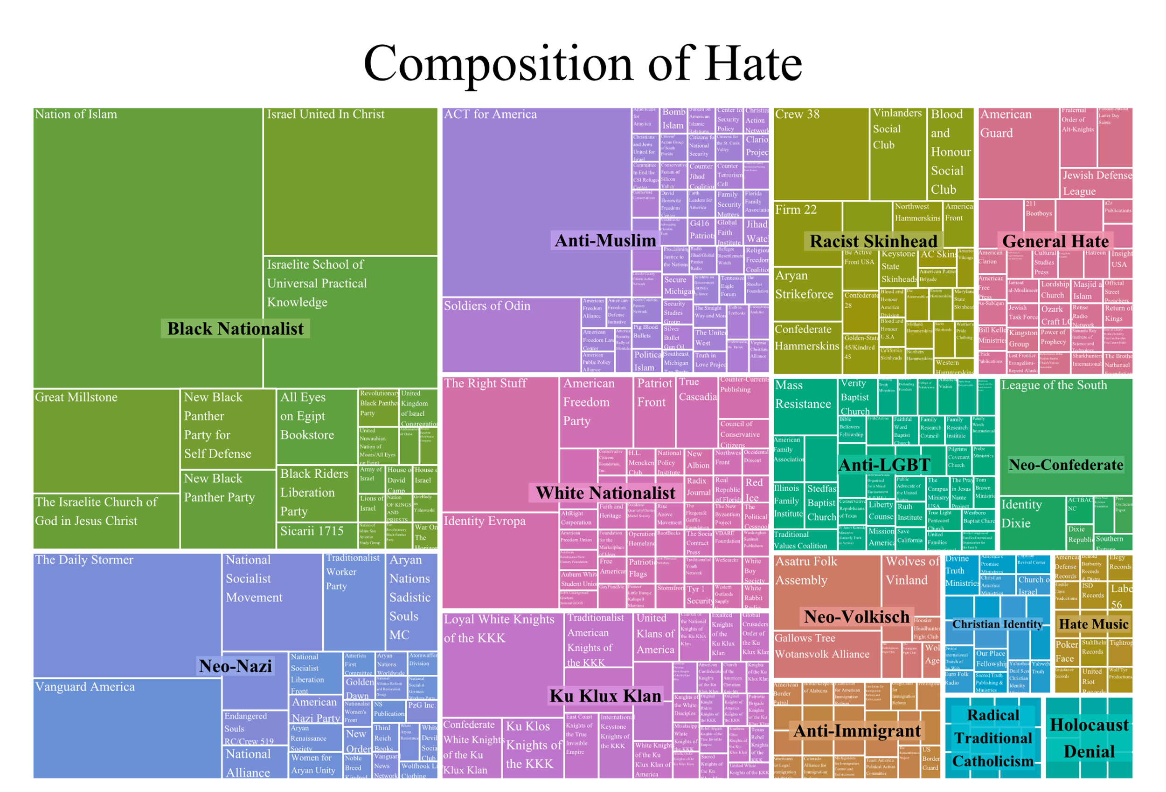
Types of Hate Groups
There were 15 hate group categories that were provided by the data, with the topic ranging from Neo-Confederates to Hate Music Groups.

Slide 6
Laws Against Hate Crimes
The definition of what constitutes a hate crime varies from state to state
It is left to the states to determine the types of laws they put in place to address these types of crimes
For my analysis, the types of hate crimes that were tested were those protecting the following demographics
Sexual orientation
Age
Disability
Race
Religious Worship
Gender
Gender Identity
Political Affiliation

Slide 7
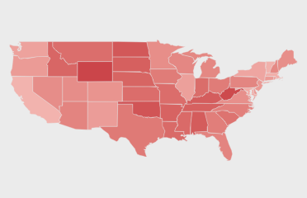
Vote-Share
Some presume that the election of Donald Trump is to blame for the spike in hate crimes.
To gauge whether this holds true, I use the percentage share of Trump’s votes for each state in the 2016 Presidential as a proxy to measure his political support

Slide 8
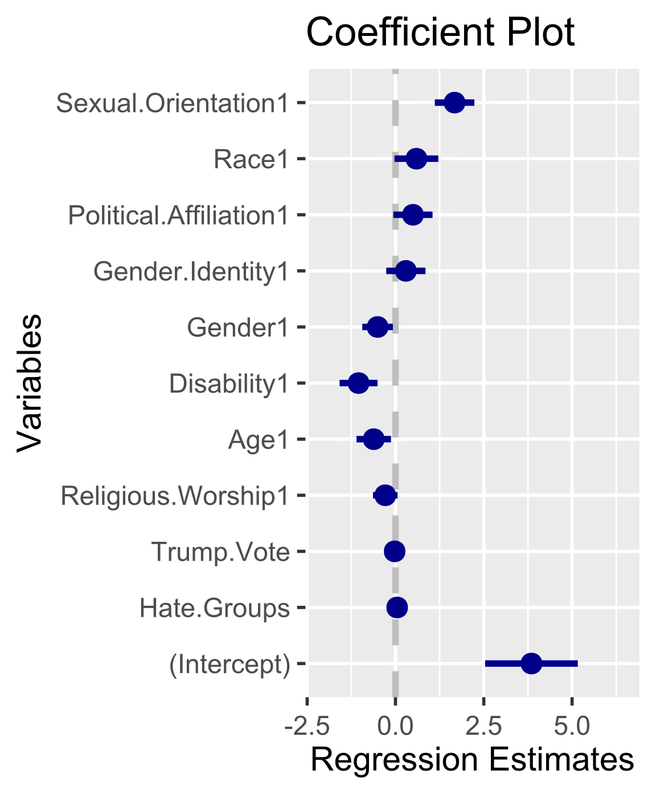
Model Results
For the statistical part of my analysis, I performed a robust regression on the log-transformed number of hate crimes in 2017 on all of the dependent variables.
The only significant variable in the model are the number of hate groups, and laws protecting disabled populations and sexual orientation.
The results of my analysis suggest that the hypothesis that there is a relationship between political support for Trump and the occurrences of hate crimes is not true, at least when using the state-level election results as an independent variable.

